Slide 1

DIT4299 Software Development Project
Ho Cheuk Ki Jacky 230091774
Pang Wang Chun 230088026
Lo Sek Kong 230154279

Slide 2

Background

Slide 3



Slide 4
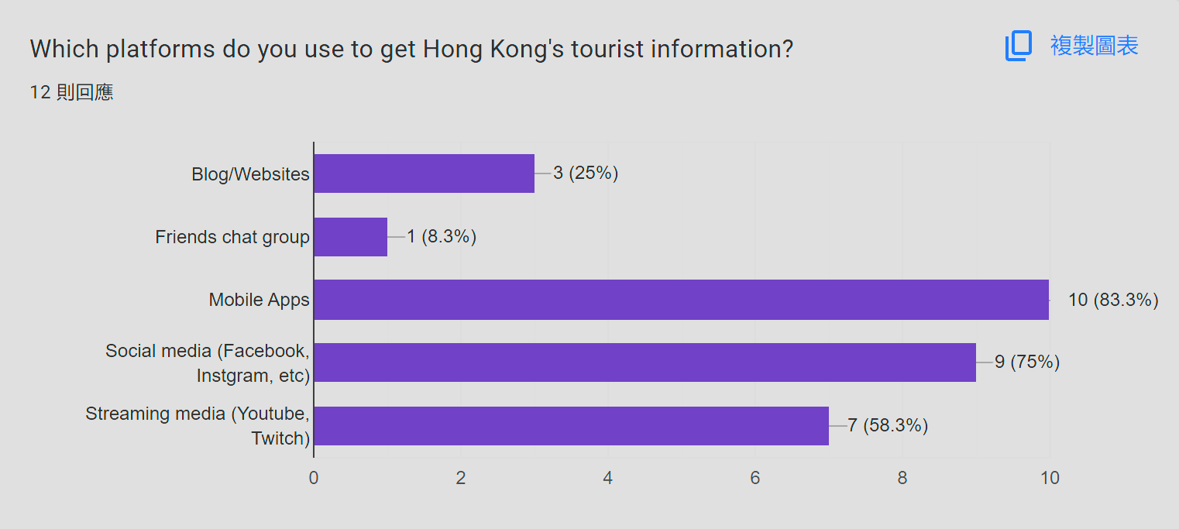
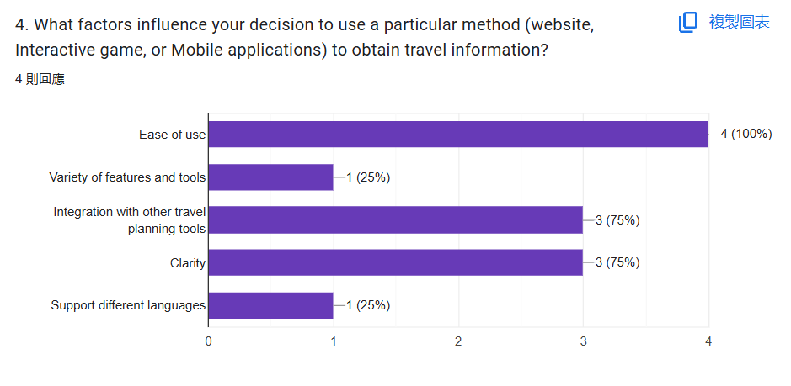
Survey

Slide 5
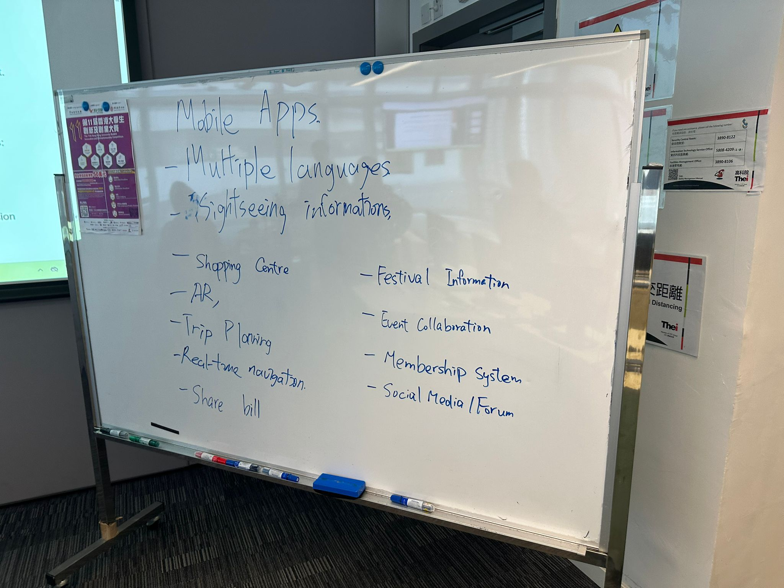

Slide 6
Planning
User Goals :
To provide sightseeing hotspots suggestions and restaurant nearby
To provide transportation suggestions
Business Goals
Promote Hong Kong tourism
Help tourism when they travel to Hong Kong
Project Goals
Keep the app simple and user friendly
Reach the user goals without compromising the business goals

Slide 7
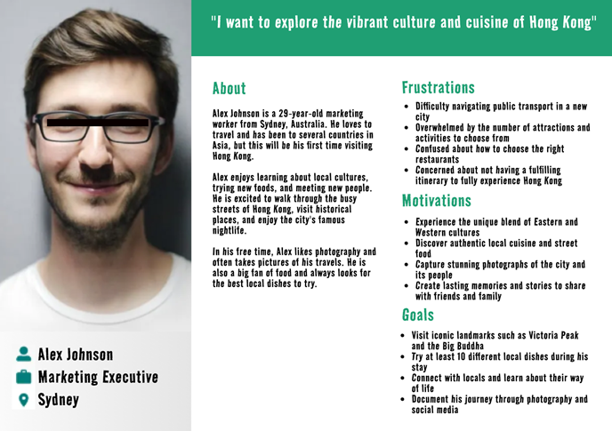

Slide 8
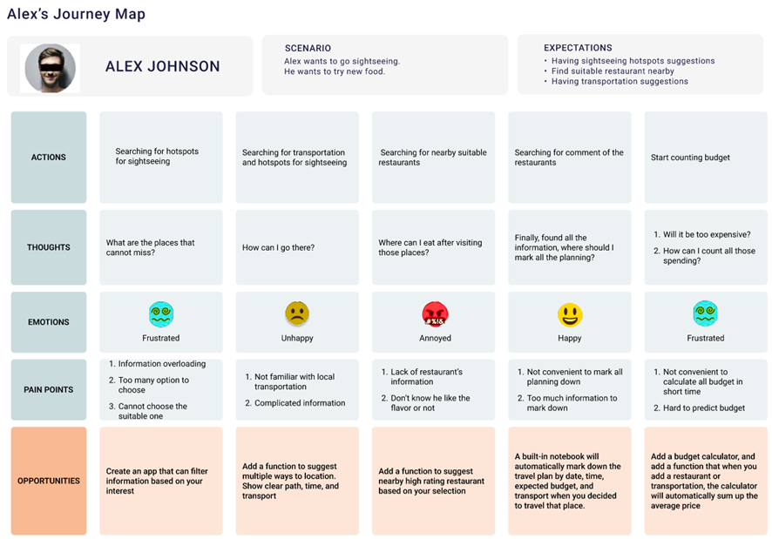

Slide 9
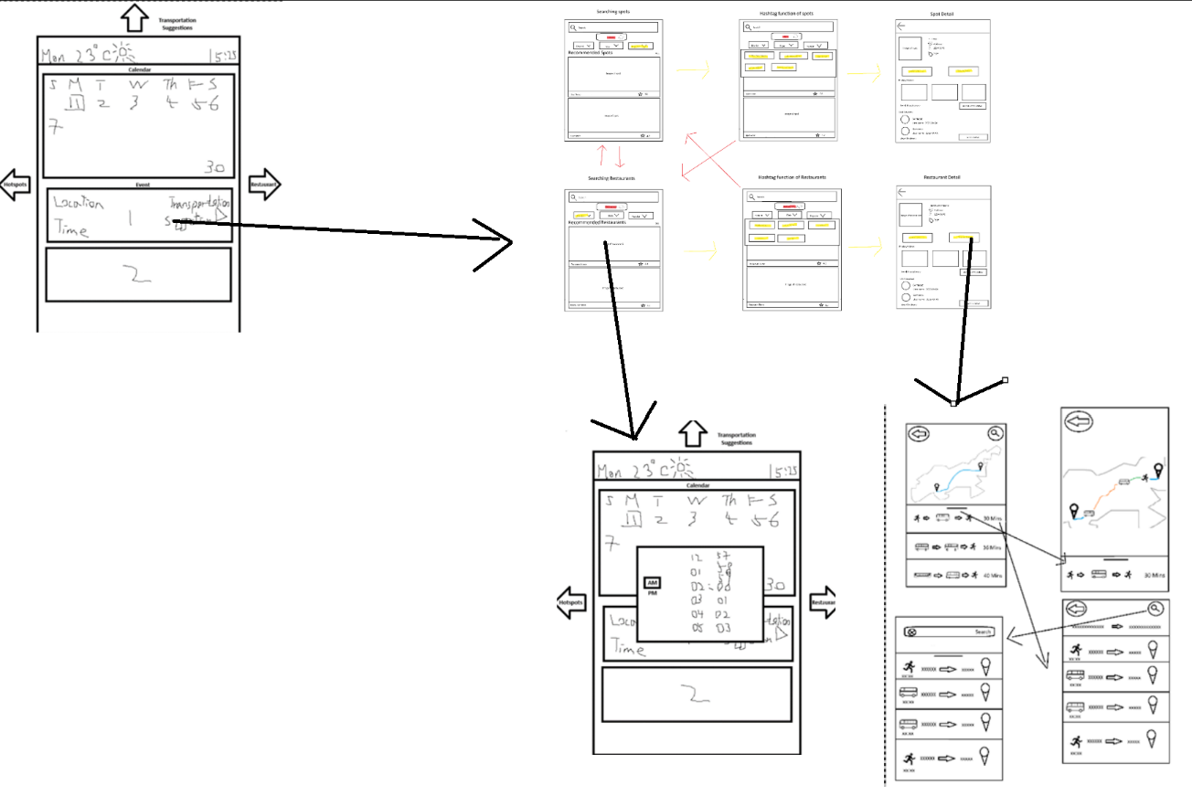

Slide 10
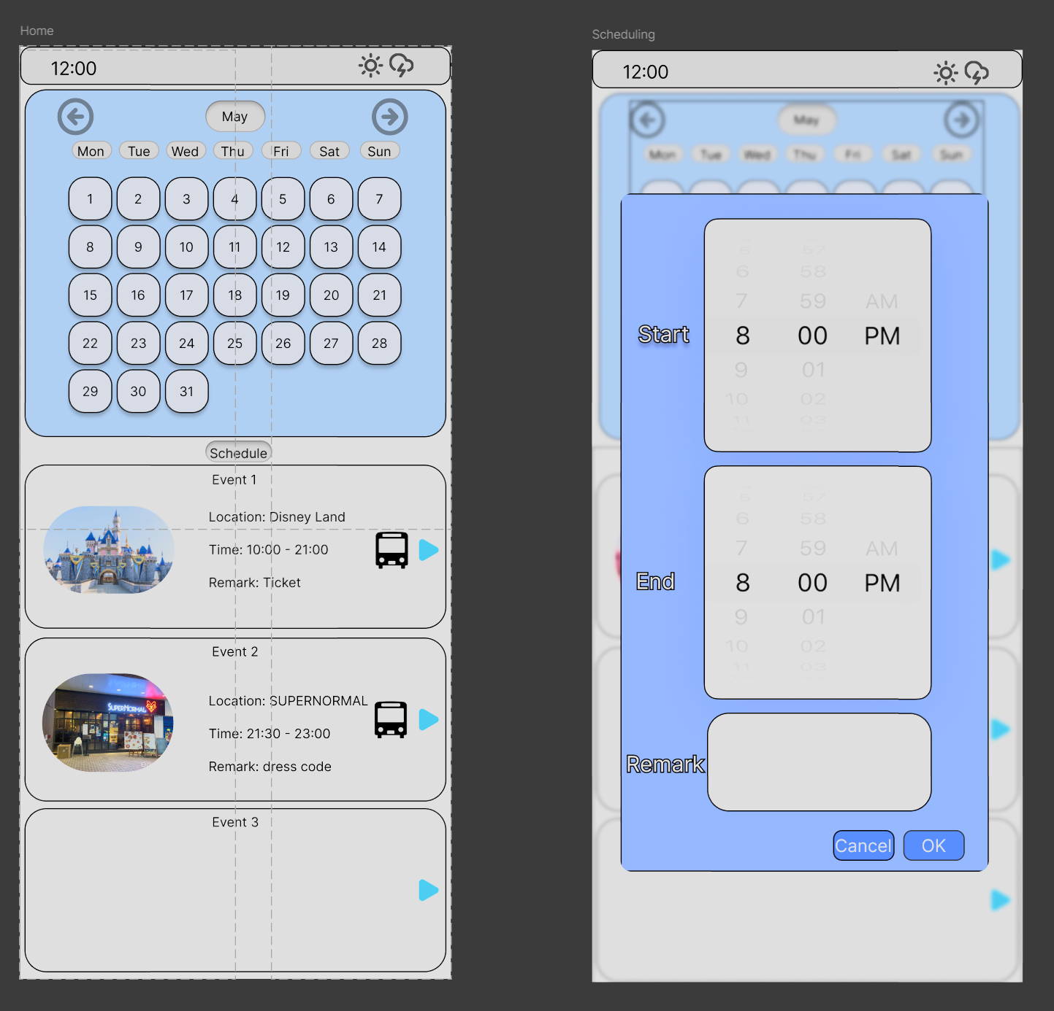
Prototype - Trip Planner

Slide 11
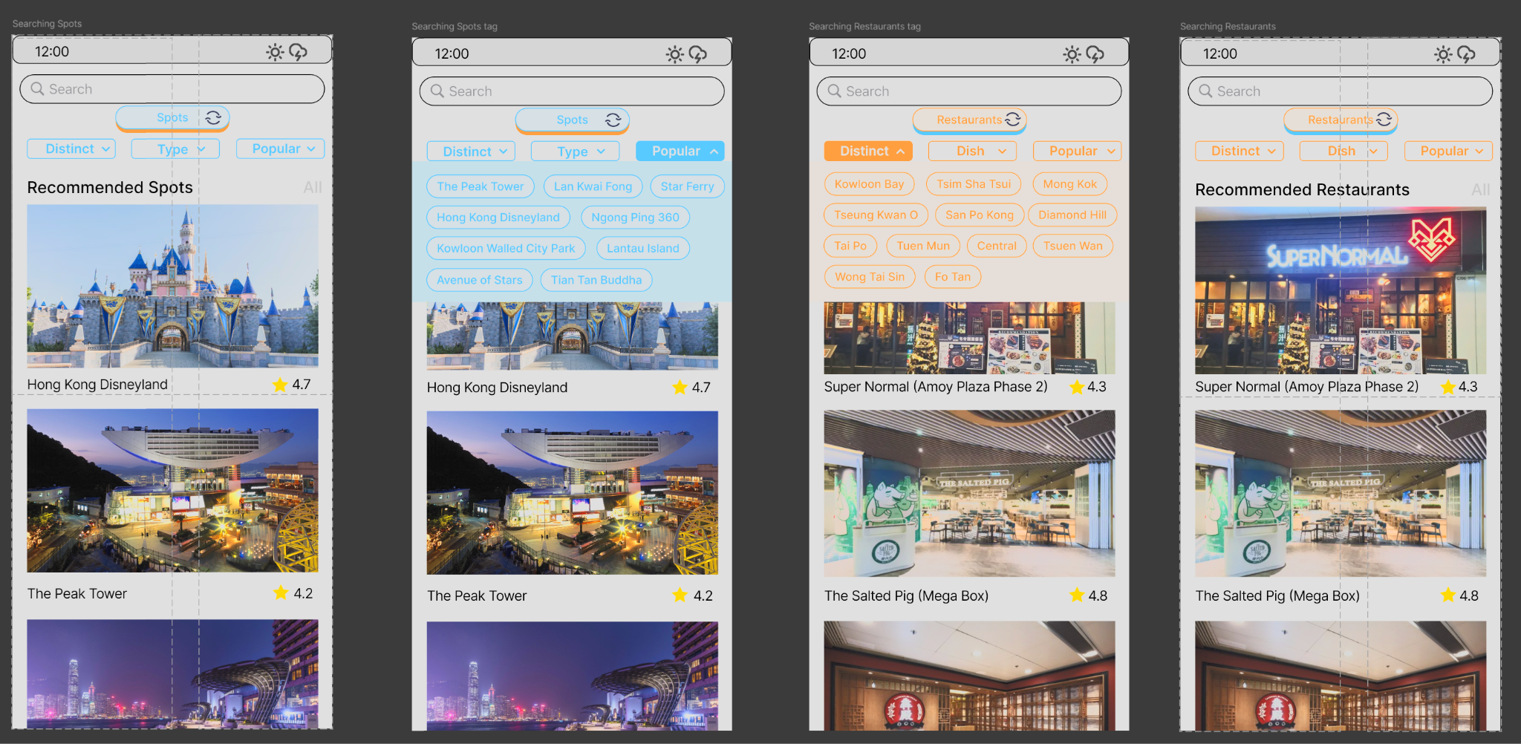
Prototype - Searching Spots & Restaurants

Slide 12
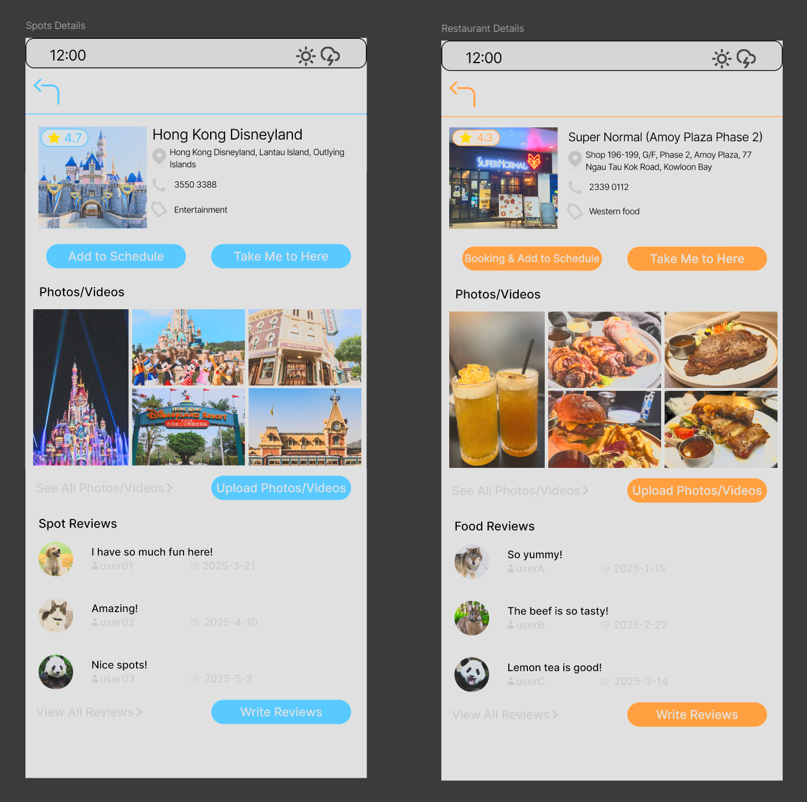
Prototype - Restaurants & Spots Details

Slide 13
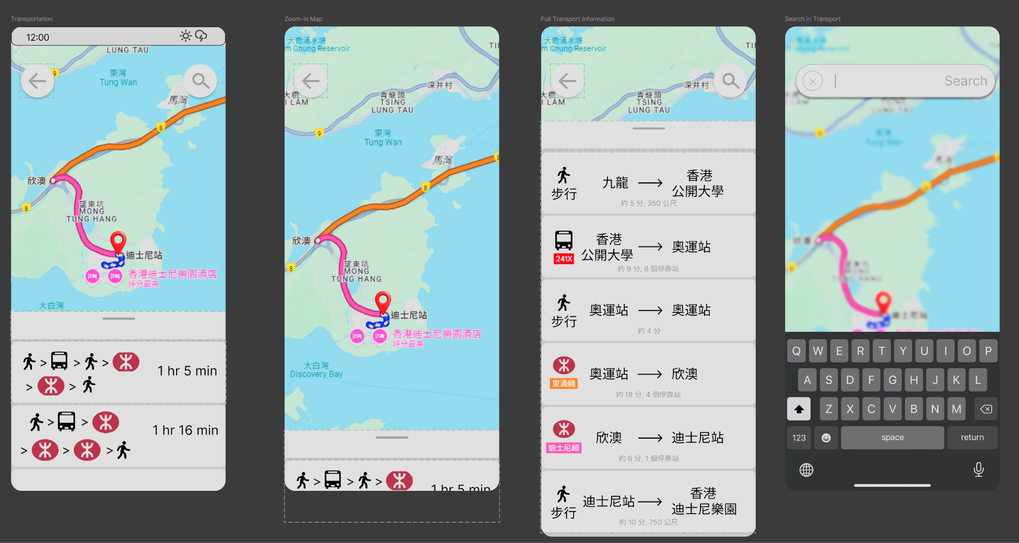
Prototype - Navigation & Transportation Suggestion

Slide 14
Prototype Demo

Slide 15
Q & A

